Slide 1

PROJECT PRESENTATION ON POWER SAVING USING APFC UNIT
Department of Electonics
And Telecommunication
Presented by:-
Shubham Kale.
Rucha Khopkar.
Kshitij Mahajan.
Guided by:-
Dr.R.Sreemathy.
Mr.V.B.Vaijapurkar.

Slide 2
Introduction:-
In the industrial sector the various motoring loads are continuously running and increasing the inductive load. So the power factor in this system get reduces due to the inductive reactive power.
The low power factor leads to the increase in the load current, increase in power loss, and decrease in efficiency of the overall system.
In previous various method used for power factor the switching of the capacitor is manual.
In this paper we are using a method of the reactive power compensation by capacitor switching with automatic control using AVR microcontroller.

Slide 3
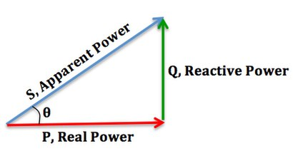
Power factor:
The power factor is the ratio of the
active power to the apparent power .
The active power is the real power delivered
to the loads such as motors, lamps etc.
The reactive power is used just for the purpose of
producing magnetic field for the flow of active
power. The apparent power is the combination of the active and
reactive power.
Power Factor= Real Power/Apparent Power
Apparent Power=Real Power + Reactive Power.

Slide 4
How does low power factor affect industries?
Majority of the loads in the industries are highly inductive in nature such as induction motors, AC/DC drives, welding machines, arc furnaces, fluorescent Lightings, electronic controls and computers.
Net industrial load is highly inductive causing a very poor lagging power factor. If this poor power factor is left uncorrected, the industry will require a high maximum demand from Electricity Board and also will suffer a penalty for poor power factor.
To improve this low power factor APFC circuit is used.

Slide 5
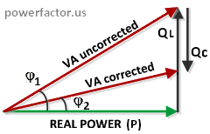
Working principle of apfc?
Capacitor banks are used to improve power factor in power factor correction circuit.
By connecting capacitor banks parallel to load, power factor is increased.
capacitor provides reactive power locally to load instead of getting from generators or power system which in return induces burden in power system. This is main objective of automatic power factor controller.

Slide 6
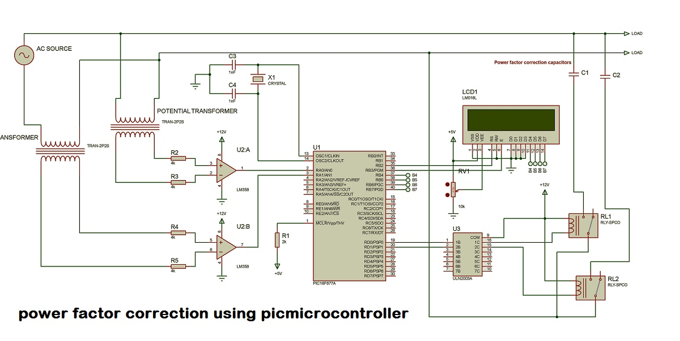
Block Diagram:-

Slide 7
Hardware Requirement:-
Current Transformer
Voltage transformers
Operational Amplifiers
PIC microcontroller
ULN2003 IC Driver
Relay
Capacitor,resisors
LCD (16*2) Display
Various Inductive and resistive loads.
SOFTWARE REQUIREMENTS:-
Microchip Mplab
Proteus
Multisim

Slide 8
References:-
"Power Factor Correction: A Guide for the Plant Engineer."
www.eaton.com/. Eaton Corporation, Aug. 2014. Web. 14 July 2016.
Available at [www.eaton.com/ecm/groups/public/@pub/.../sa02607001e.pdf]
"Microcontroller." Wikipedia
[https://en.wikipedia.org/wiki/Microcontroller]. Wikipedia Foundation,
http://www.electricaltechnology.org/2013/10/causesof-low-power-factor.html
IEEE TRANSACTIONS ON INDUSTRIAL ELECTRONIC VOL

Slide 9


